Slide 1
Anıme recommendatıon system
Muhammet ozturk
150200328

Slide 2

Importance of The Recommendatıon Systems
Recommendation systems are pivotal in modern digital platforms, offering a multitude of benefits. They personalize the user experience by tailoring content to individual preferences, significantly enhancing engagement and satisfaction. This personalization is not just beneficial for users but also drives business value. By suggesting relevant products or content, these systems boost sales, customer retention, and overall revenue.
Moreover, in an era of information overload, recommendation systems efficiently filter content, helping users quickly find what interests them. This efficiency saves time and improves the browsing experience, making these systems indispensable in various digital services.

Slide 3

Types of Recommendatıon Systems
Collaborative Filtering
Content-Based Filtering
Hybrid Systems

Slide 4
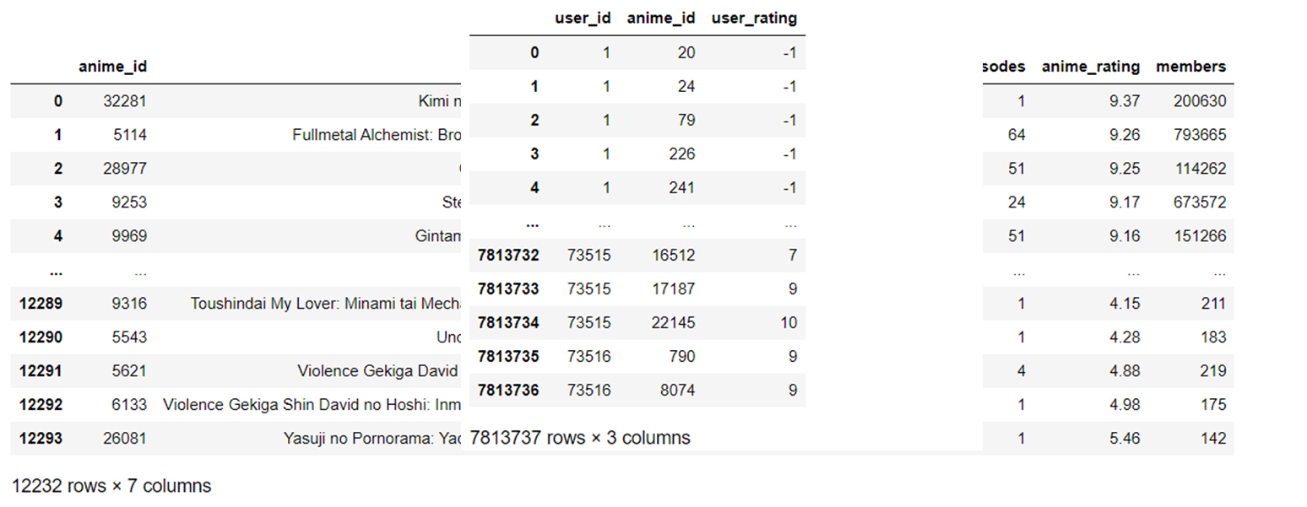
Datasets
In this project, we employed two substantial datasets to enhance our analysis. The first, named 'anime.csv', encompasses a wide range of details including anime names, anime IDs, and various ratings. The second dataset, 'rating_csv', complements the first by offering insights into user behaviors, specifically through user IDs and the ratings they have assigned. Together, these datasets provide a comprehensive view of user preferences and anime characteristics, forming the foundation of our study.

Slide 5
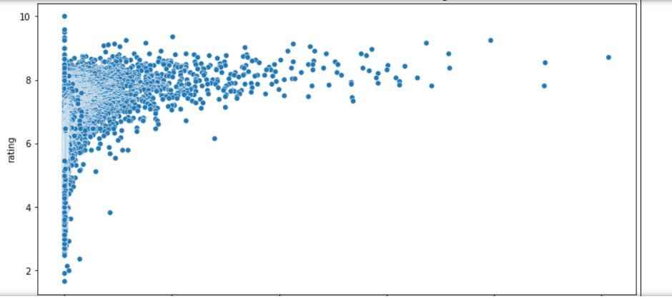
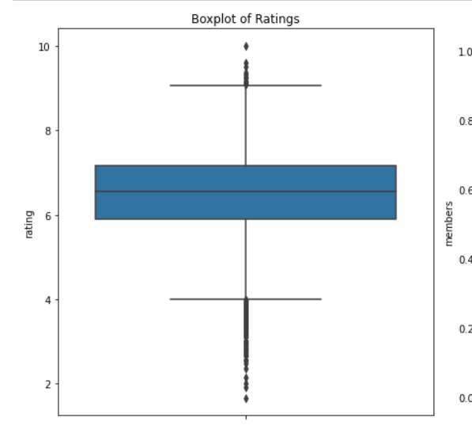
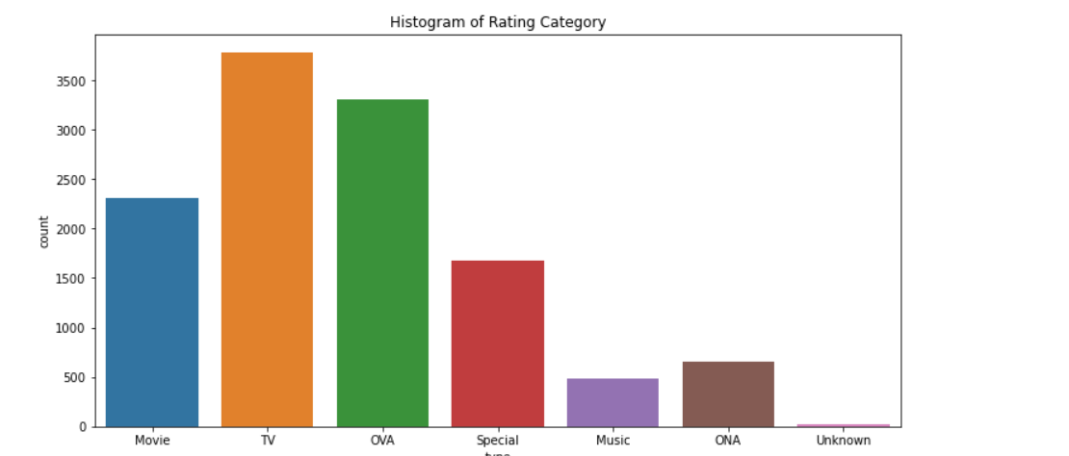
Data preparatıon and analyze
After initiating our data mining project, we transitioned into the crucial phase of data preparation. This stage involved meticulously organizing and conditioning our datasets for optimal use in our model. The key activities included:
1-Data Visualization: We employed various visualization techniques to understand the underlying structure and distribution of our data. This process was essential for gaining insights into the patterns and trends inherent in our datasets.

Slide 6
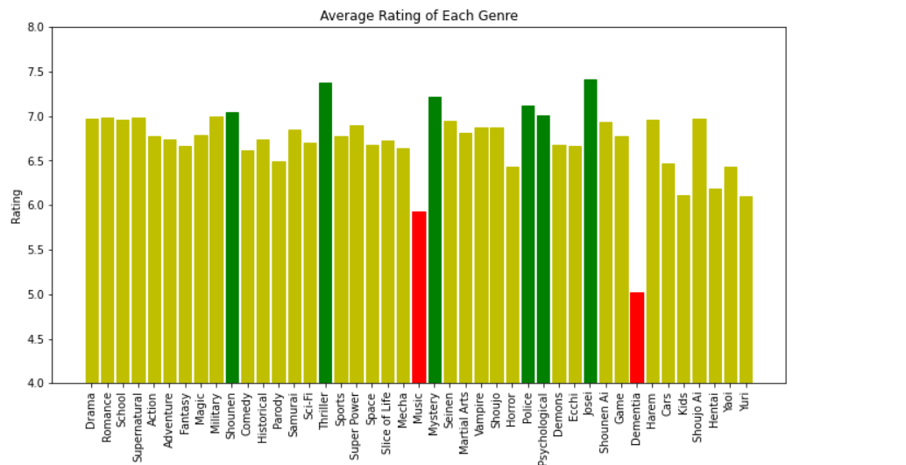
In our data preparation process, handling missing values was a critical step. We began by thoroughly identifying all instances of missing data in our datasets. Once identified, we analyzed the patterns and causes of these missing values to determine the best course of action.
Depending on the nature of the missing data, we employed various strategies.
Upon identifying the missing values, we categorized them based on their characteristics and the patterns of their occurrence. This categorization helped us understand whether the missing data was random or followed a specific pattern, and whether it was concentrated in certain variables or dispersed throughout the dataset.

Slide 7
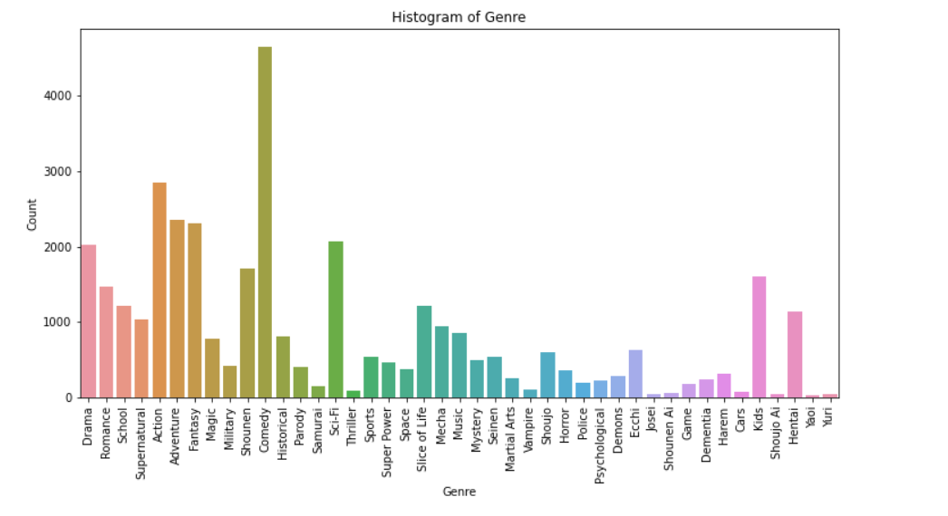
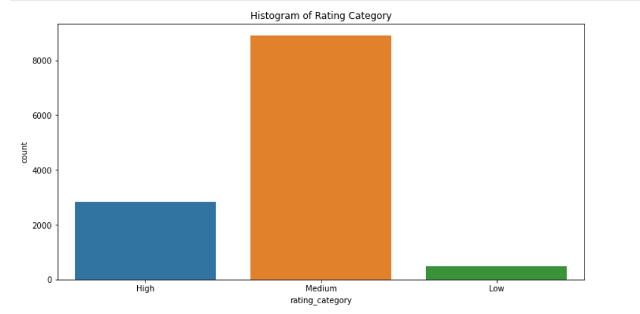
Feature Engineering: A significant part of our data preparation involved feature engineering. This process entailed creating new features from the existing data and transforming data into formats more suitable for modeling. By doing so, we enhanced our model's ability to learn from the data, increasing its predictive accuracy and performance.
This meticulous data preparation, including the crucial step of feature engineering, was foundational in ensuring that our model would be trained on clean, reliable, and relevant data. It enhanced the accuracy and effectiveness of our data mining efforts, setting a strong foundation for the subsequent modeling phase.

Slide 8
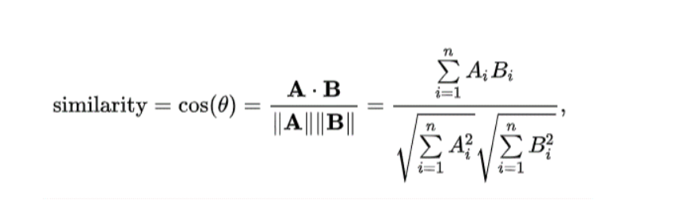
Our model
The core of our recommendation system was based on the use of cosine similarity as a similarity measure. This metric allowed us to calculate the similarity between user profiles and item features by measuring the cosine of the angle between two vectors in a multidimensional space. This method was particularly effective as it was independent of the magnitude and focused purely on the orientation, making it ideal for our diverse and sparse dataset.

Slide 9
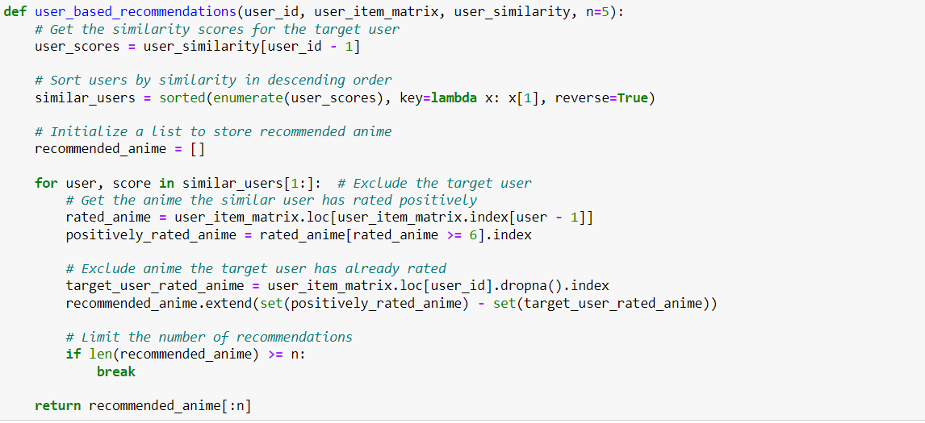
With the similarity scores calculated, our system then generated personalized recommendations for each user. It identified items that were closely aligned with the user's profile and preferences, as indicated by the high cosine similarity scores. These recommendations were tailored to reflect the unique tastes and interests of each user, enhancing user engagement and satisfaction.
By integrating user ratings with item-based characteristics and employing cosine similarity for measuring similarities, our content-based recommendation system offered a highly personalized and dynamic user experience. It stood as a testament to the power of advanced data analytics and machine learning in enhancing user engagement in digital platforms.

Slide 10
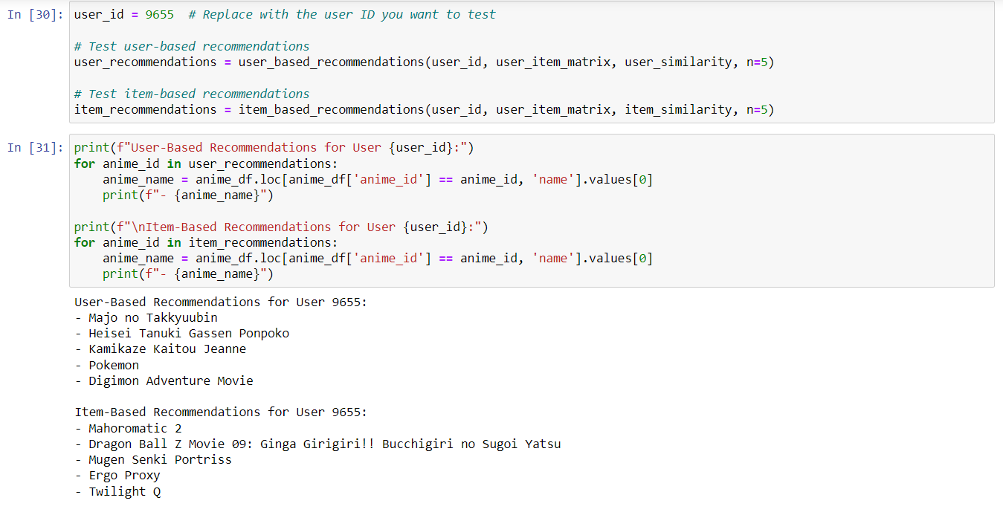
After the meticulous construction of our model, we embarked on a critical phase: rigorous testing. This stage was vital to assess the effectiveness and reliability of our model and to ensure it met our predefined objectives and expectations.
Remarkably, the test results aligned closely with our desired outcomes. The model is performing well across the various metrics we had set. This success was a testament to the robustness of our data preparation, the soundness of our algorithmic choices, and the effectiveness of our feature engineering.

Slide 11
Related works
https://ar5iv.labs.arxiv.org/html/2306.12680
Castellano G, Fanelli AM, Torsello MA. NEWER: A system for neuro-fuzzy web recommendation. Appl Soft Comput. 2011;11:793–806.
Crespo RG, Martínez OS, Lovelle JMC, García-Bustelo BCP, Gayo JEL, Pablos PO. Recommendation system based on user interaction data applied to intelligent electronic books. Computers Hum Behavior. 2011;27:1445–9.
Wang SL, Wu CY. Application of context-aware and personalized recommendation to implement an adaptive ubiquitous learning system. Expert Syst Appl. 2011;38:10831–8.
Lorenzi F, Bazzan ALC, Abel M, Ricci F. Improving recommendations through an assumption-based multiagent approach: An application in the tourism domain. Expert Syst Appl. 2011;38:14703–14.

